Slide 1
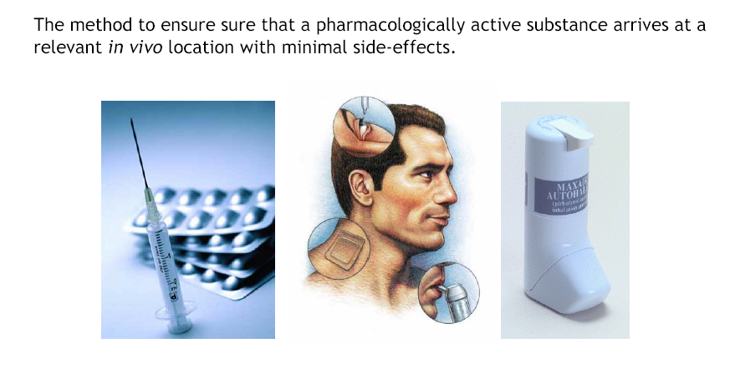
Drug Delivery

Slide 2
Drug Delivery
Conventional
Controlled
In general medicine, enteral is feeding or drug administration by the digestion process of a gastrointestinal (GI) tract.
Parenteral is taken into the body or administered in a manner other than through the digestive tract, as by intravenous or intramuscular injection
Enteral
Sustained
Extended
Parenteral
Site-specific
Other
Pulsatile

Slide 3
Oral Administration
Advantages
Patient: Convenience, not invasive, higher compliance
Manufacture: well established processes, available infrastructure
After a drug is swallowed, it is absorbed by the digestive system and enters the hepatic portal system. It is carried through the portal vein into the liver before it reaches the rest of the body. The liver metabolizes many drugs, sometimes to such an extent that only a small amount of active drug emerges from the liver to the rest of the circulatory system. This first pass through the liver thus greatly reduces the bioavailability of the drug.
Disadvantages
Unconscious patients cannot take dose
Low solubility
Low permeability
Degradation by GI enzymes or flora
First pass metabolism
Food interactions
Irregular absorption

Slide 4
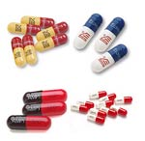
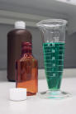
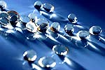
Oral Administration
Traditional oral delivery systems
Tablets
Capsules
Soft gelatin capsules
Suspensions

Slide 5
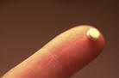
Buccal/Sublingual
Advantages
By-pass First pass metabolism
Rapid absorption
Low enzymatic activity
Disadvantages
Discomfort during dissolution
Probability of swallowing- lost of effect
Small doses
Traditional delivery system/devices
Tablets
Chewing gum

Slide 6
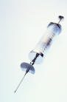
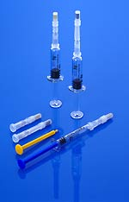
Intravenous (IV)
Advantages
Drug 100% bioavailable
Rapid response
Total control of blood concentration
Maximize incorporation of degradable drugs
By-pass FPM
Disadvantages
Invasive
Trained personnel
Possible toxicity due to incorrect dosing
sterility
Traditional delivery system/devices
Injection-bolus
IV bag - infusion

Slide 7
Subcutaneous
Advantages
Patient self-administration
Slow, complete absorption
By-pass FPM
Disadvantages
Invasive
Irritation, inflammation
Maximum dose volume - 2mL

Slide 8
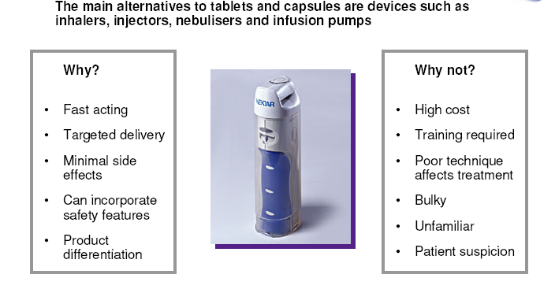
Inhalers

Slide 9
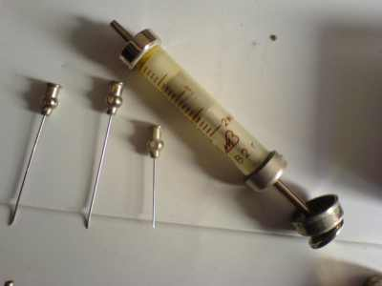
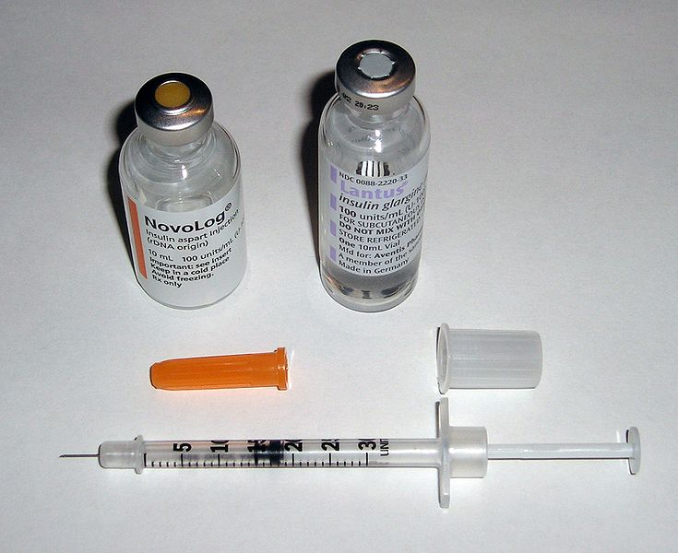
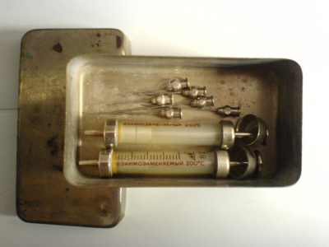
Insulin Delivery Modes Syringes
Improved Technology:
disposable
thinner needles
more sanitary
Notes:
9

Slide 10
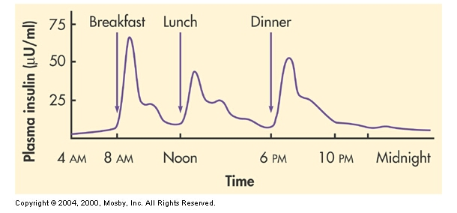
Insulin Secretion

Slide 11
Basal and bolus insulin concept
Basal insulin
Suppresses glucose production between meals and overnight
Nearly constant levels
Upto 40 to 50% of daily needs
Bolus insulin (mealtime)
Limits hyperglycemia after meals
Immediate rise and sharp peak after 1 hour
Approx 10 to 20% of daily requirement at each mealtime

Slide 12
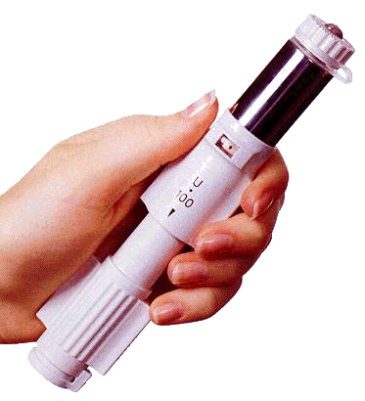
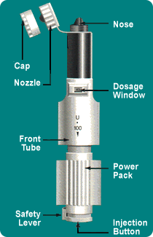
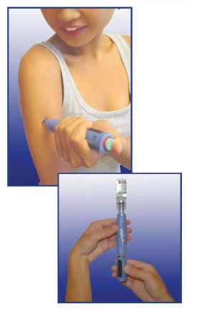
Insulin Delivery Modes Jet Injectors
sends insulin through the skin , using high pressure mechanism
an option for people with severe needle phobia

Slide 13
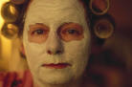
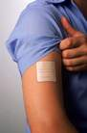
Transdermal
Advantages
Local effect
Ease of administration
Disadvantages
Low absorption for some drugs
May cause allergic reactions
Requirements
Low dosage <10 mg/mL
MW< 1,000

Slide 14
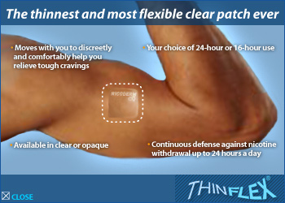
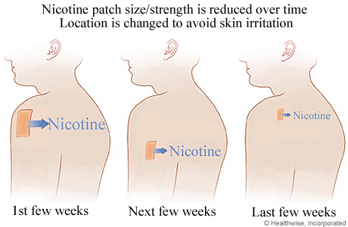
Limitations of Transdermal Delivery Systems
Skin structure poses a barrier on the mw of the drug (< 500 Da)
Usually reserved for drugs which are extremely potent (thus requiring a dosage of only a few mg).
The largest daily dose of a drug from a patch is the nicotine patch, with delivers a daily dose of only 21 mg.

Slide 15
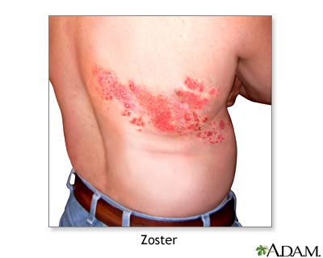
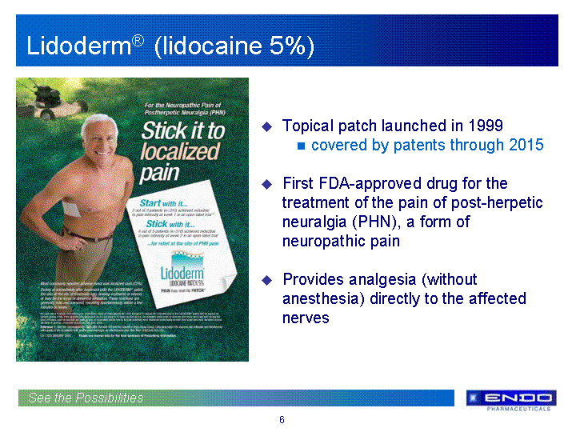
Lidocaine
Product Name = Lidoderm®
Used for: analgesia of postherpetic neuralgia (PHN), a painful condition caused by the varicella zoster virus (herpes zoster = shingles)

Slide 16
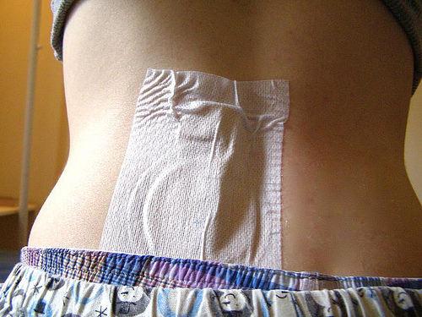
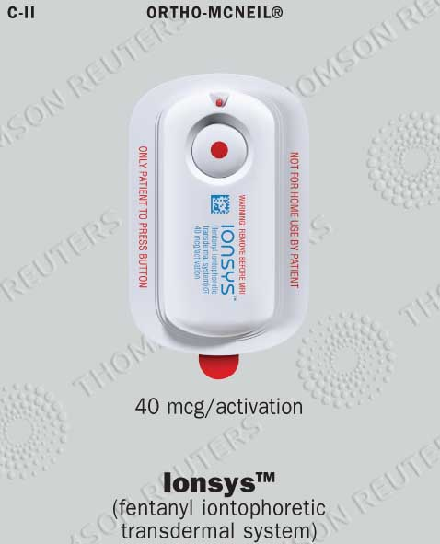
Iontophoretic Patches
Iontophoretic patches use a tiny electrical current to promote flow of the drug (usually charged) through the skin.

Slide 17
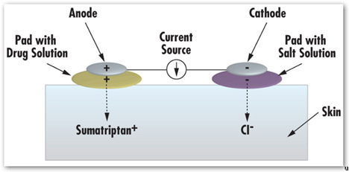
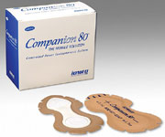
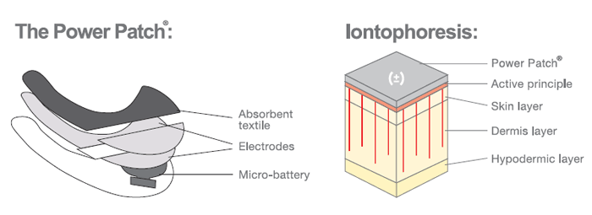
Iontophoretic Patches

Slide 18
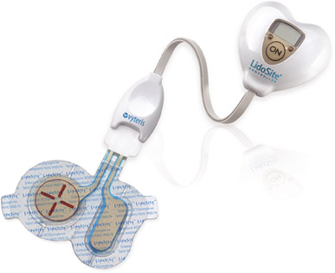
Iontophoretic Patches
Lidocaine + Epinephrine
Product name = Lidosite
Used for: Dermal anesthesia
Type of Patch = Reservoir, iontophoretic.
Epinephrine acts as vasoconstrictor, thus prolonging the duration of action of lidocaine (by delaying resorption) at the site

Slide 19
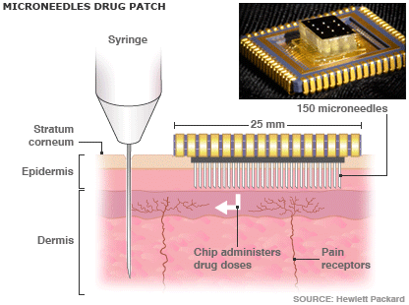
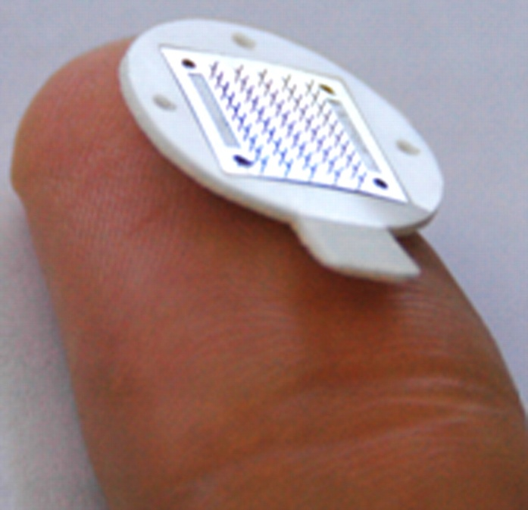
Microneedles Patches
Microneedles patches are currently being explored as mechanisms to deliver vaccines and larger macromolecules.

Slide 20
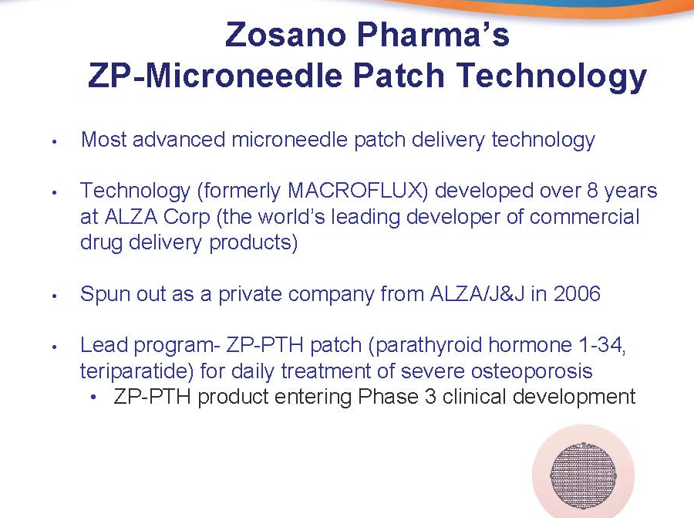

Slide 21
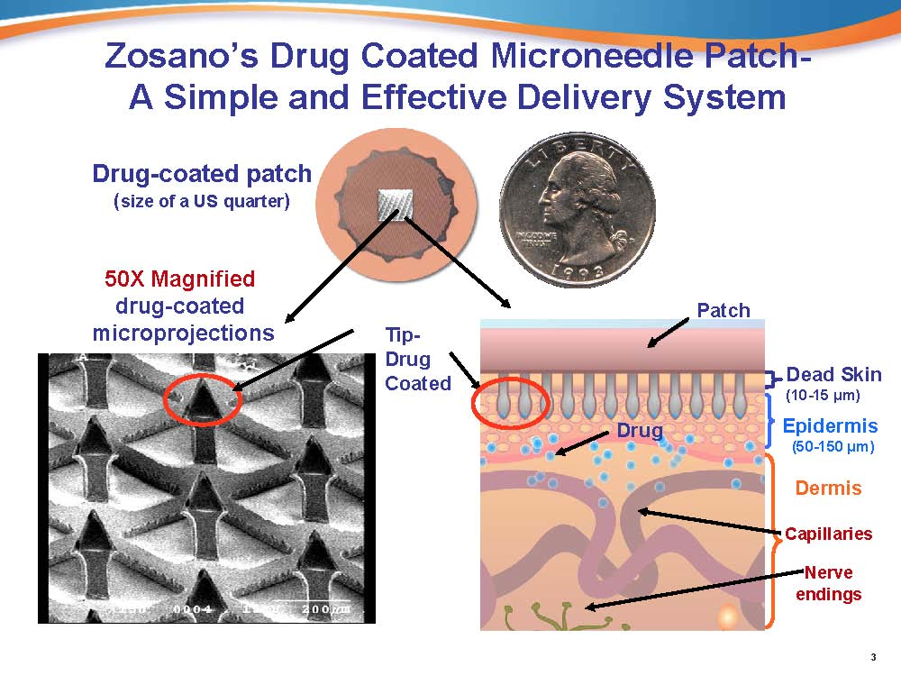

Slide 22
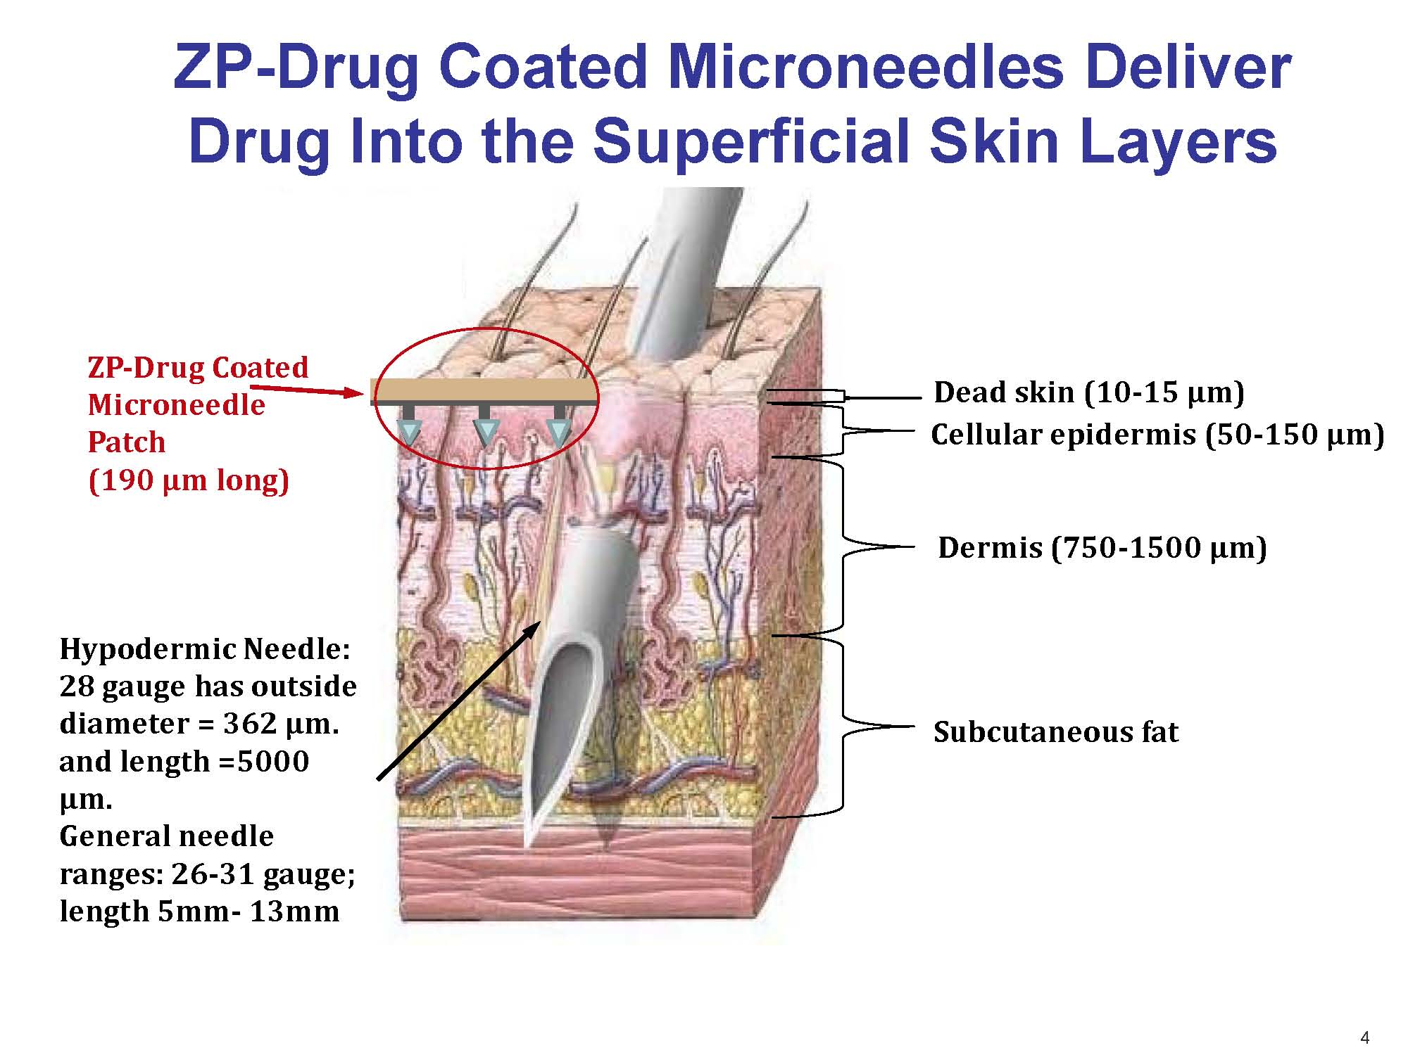

Slide 23
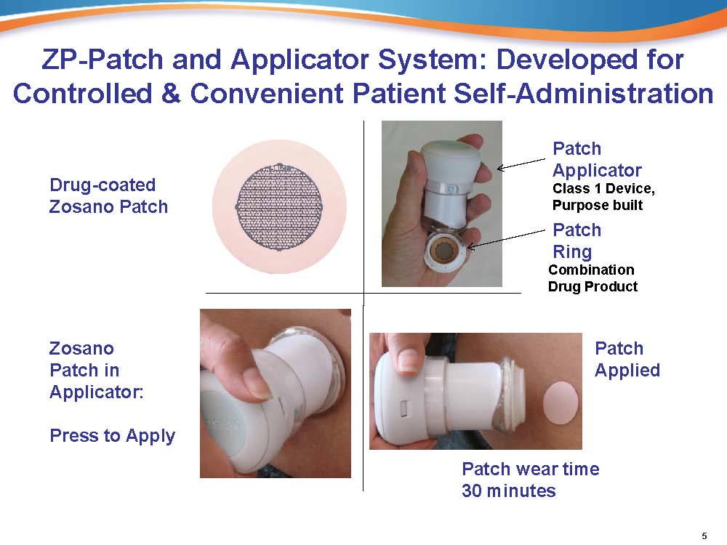

Slide 24
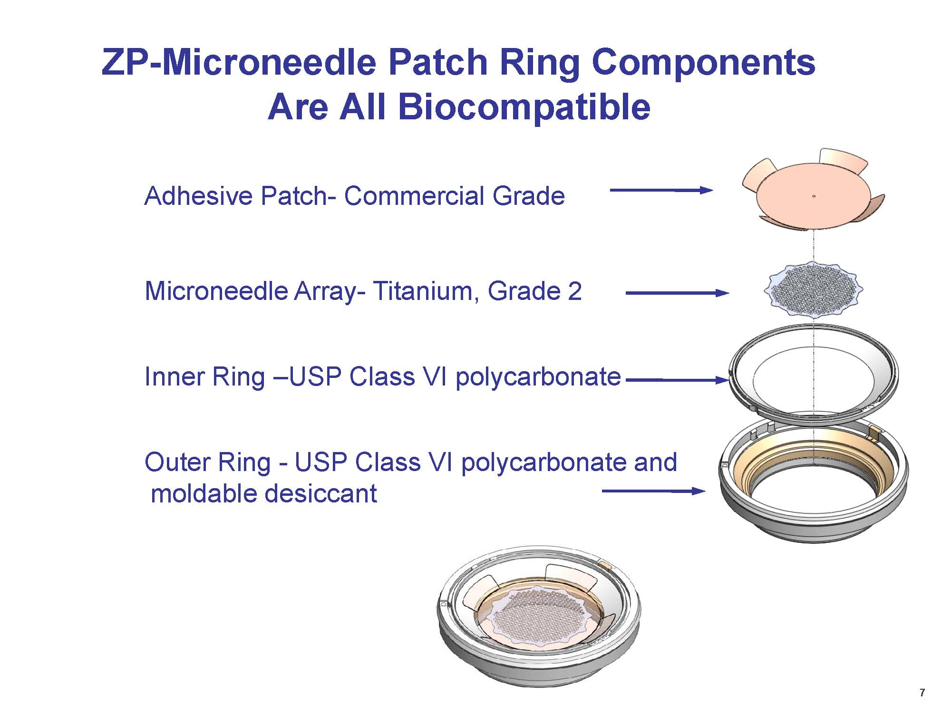

Slide 25
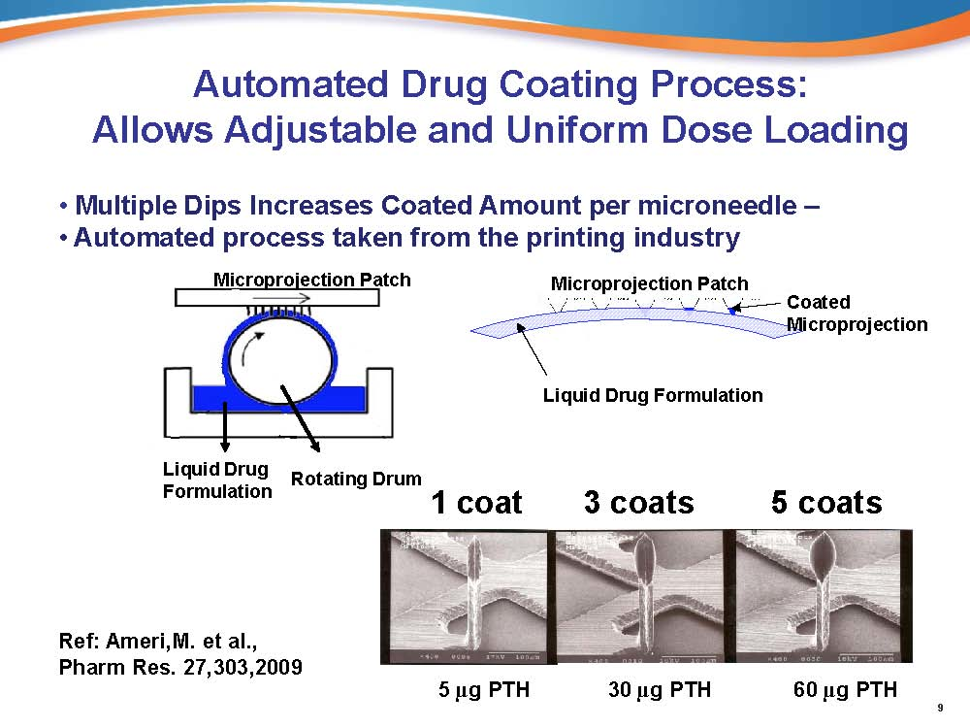

Slide 26
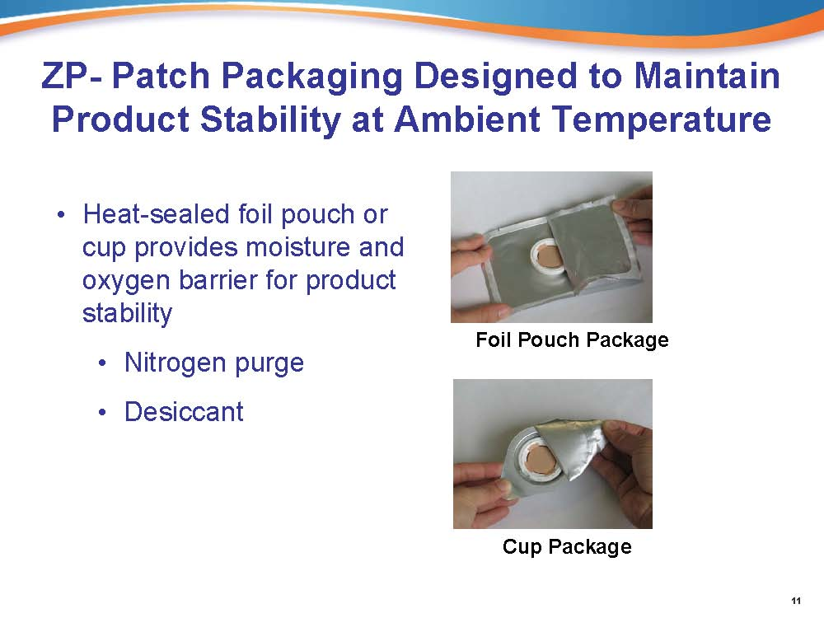

Slide 27
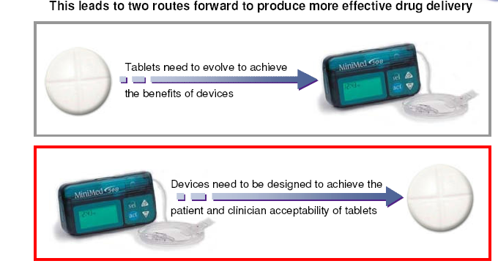

Slide 28
Model Questions for Section III of 32 marks
Name 2 designs for artificial valves? (2 marks)
Name 2 products for HIV testing (1 mark)
PCR is used in which technology (1 marks)
Give 2 glucose sensing devices (2 marks)
Give 2 active and 2 passive drug delivery devices (2 marks)

